Slide 1

Data-Driven Insights for Enhancing British Airways Customer Experience

Slide 2
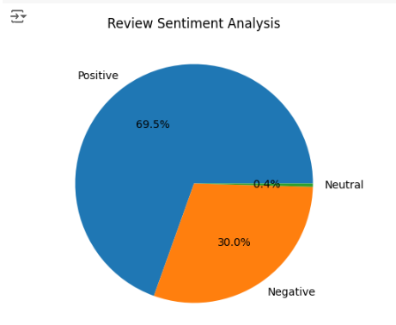

Summary of Findings
From our analysis, we identified common themes such as customer experiences, service interactions, quality, travel logistics, and comfort. While the majority of reviews are positive, a notable portion is negative or neutral, with frequent mentions of "flight," "crew," "seat," "service," and "experience." These insights highlight our strengths and pinpoint areas for improvement to enhance customer satisfaction.

